Slide 1
CNN-AE Report

Slide 2
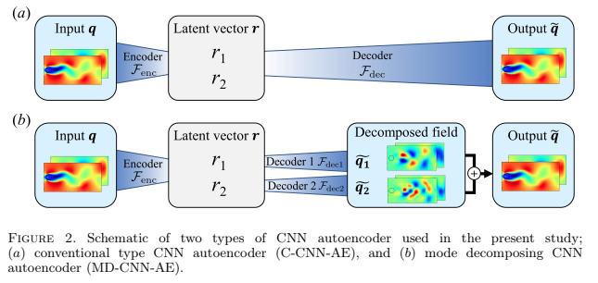

Slide 3
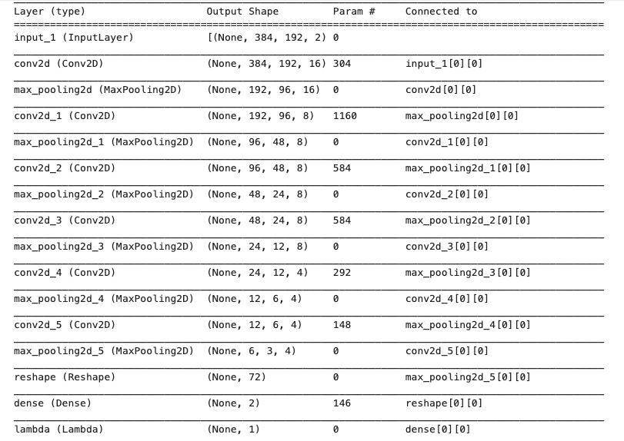
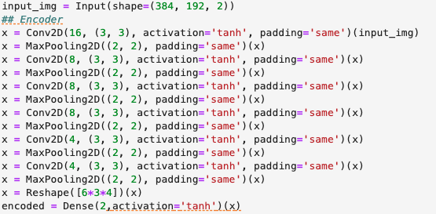
Model structure
the shape of width m, height n, previous layer’s filters d and account for all such filters k in the current layer
((m * n * d)+1)* k)
For example,
# params of 2nd layer: ((3*3*2)+1)*16 = 204
# …of 4th layer: ((3*3*16)+1)*8=1160

Slide 4

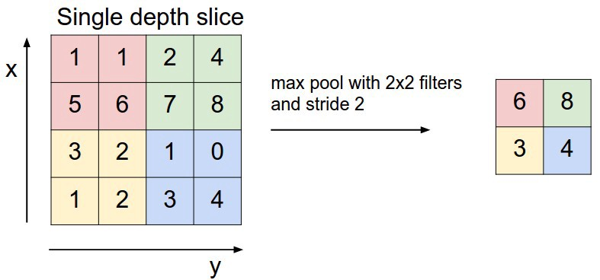
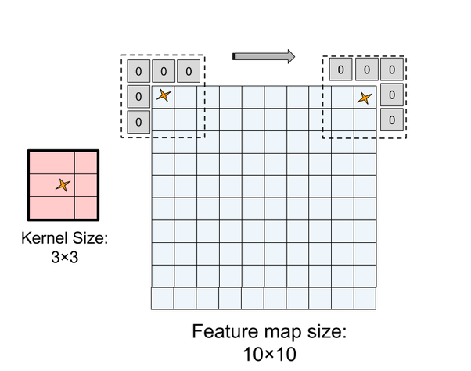
Output = (384-3+2*1)/1 + 1 = 384
Max pooling with kernel size (2x2) -> new dimension will be reduced 1/2
# param1 = 3*3*16*2+16 = 304
# param2 = (3*3*16*8) + 8 = 1160

Slide 5
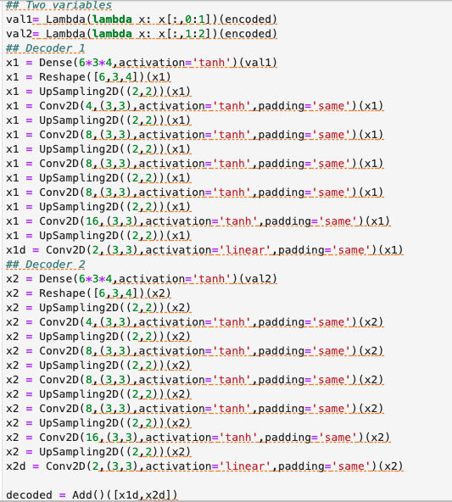

Slide 6
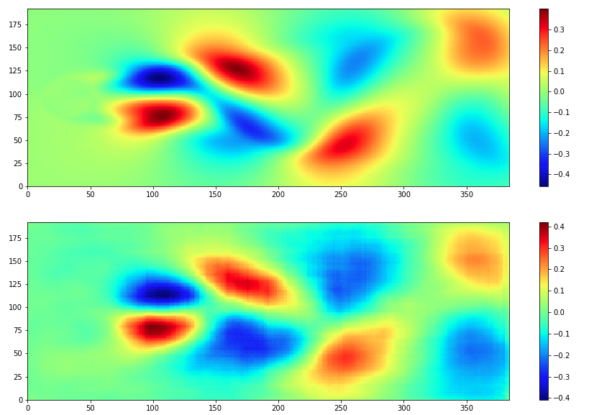
Output with 2 latent variables (2 decoders)
Comparison of reference input snapshot with its corresponding output (U vector)

Slide 7
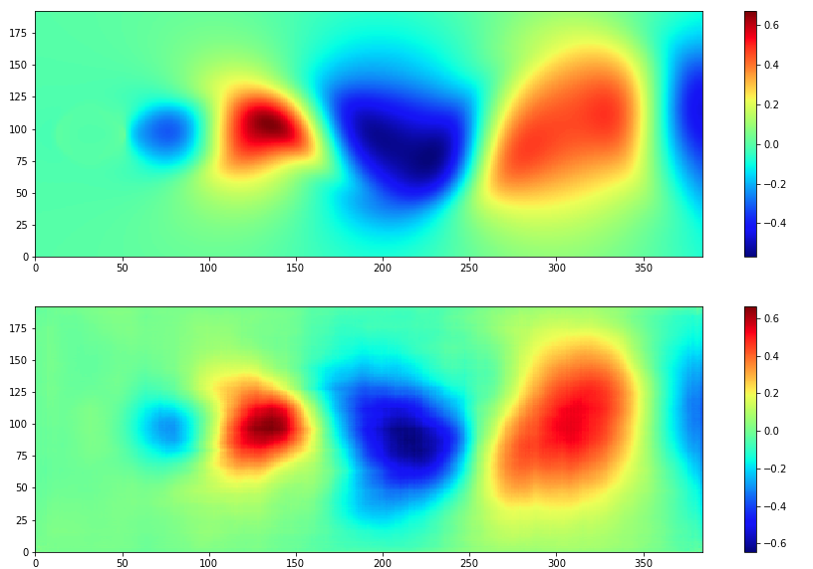
Output with 2 latent variables (2 decoders)
Comparison of reference input snapshot with its corresponding output (V vector)

Slide 8
First 10 snapshots (2 decoders)

Slide 9
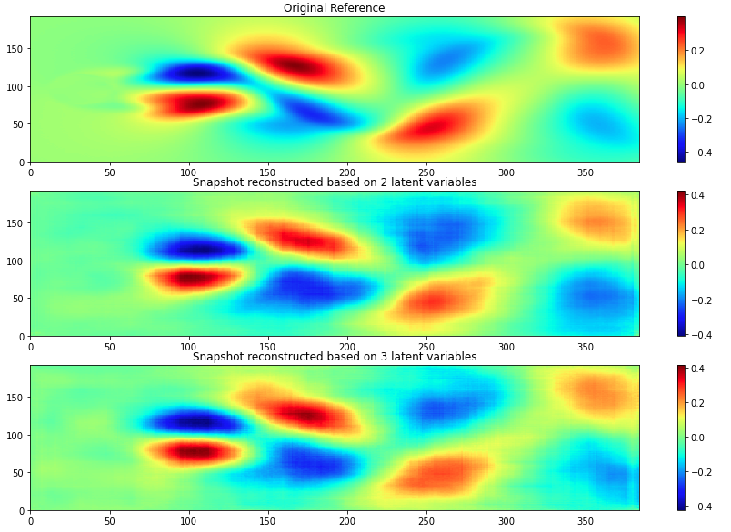

Slide 10
Changing input dimension
800
192
200
384
800
768
200
192

Slide 11
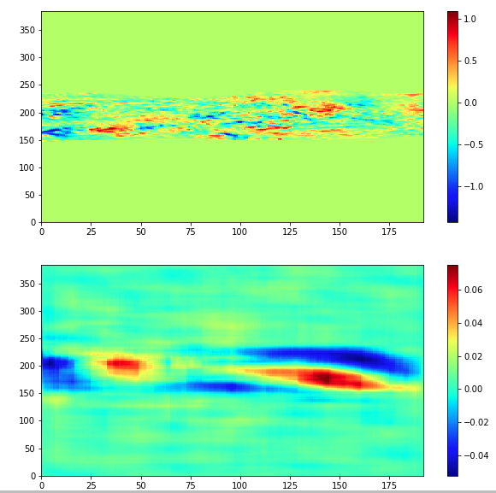
384x192

Slide 12
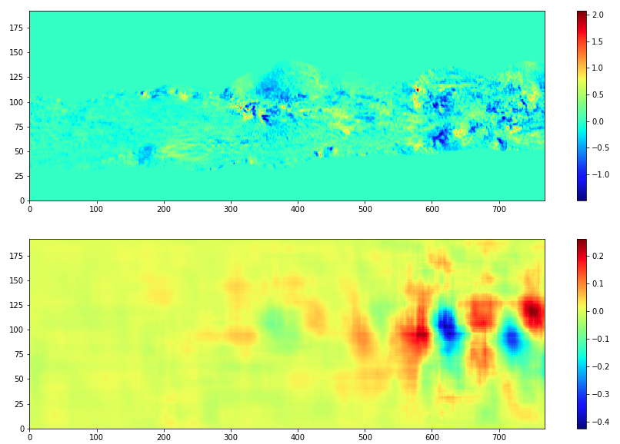
192x768

Slide 13
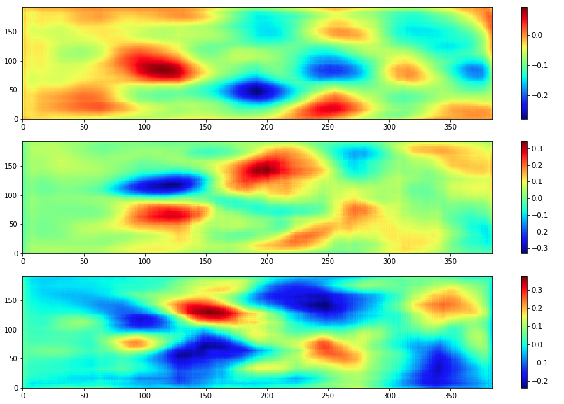
X1d , x2d , x3d visualization

Slide 14
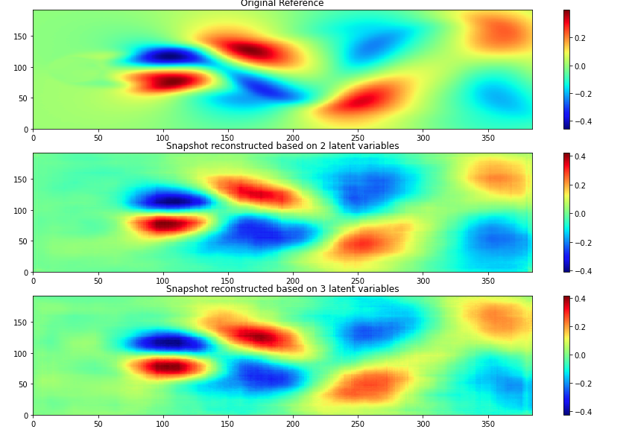
Original vs add[x1d , x2d ], add[x1d , x2d , x3d]

Slide 15
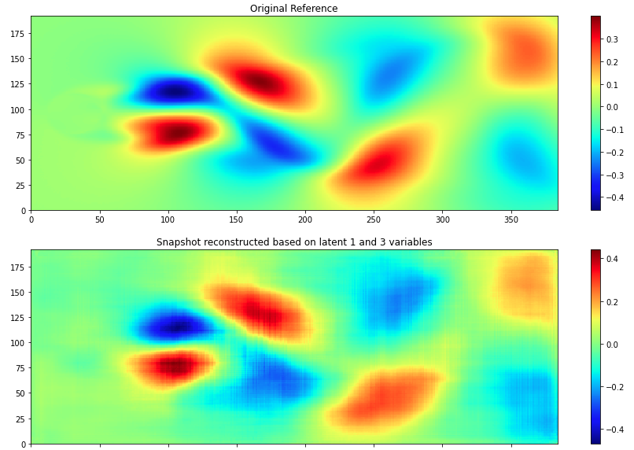
Original vs add [x1d , x3d ]

Slide 16
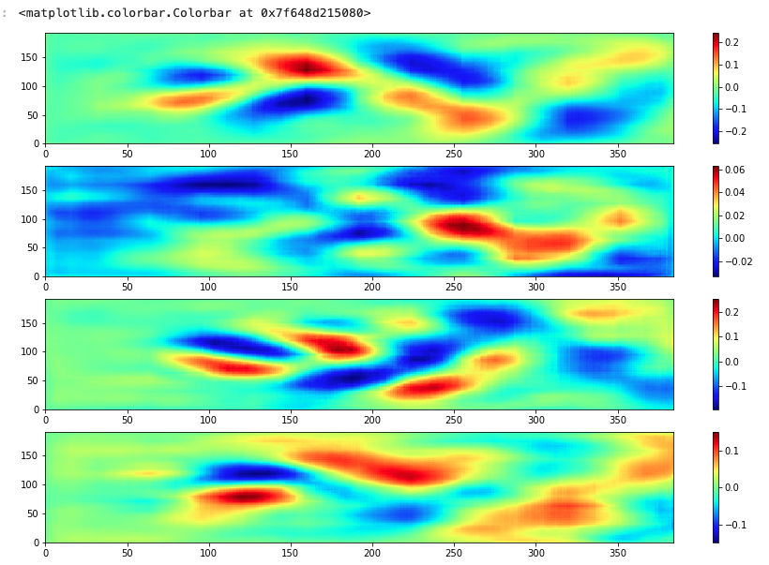
X1d , x2d , x3d , x4d

Slide 17
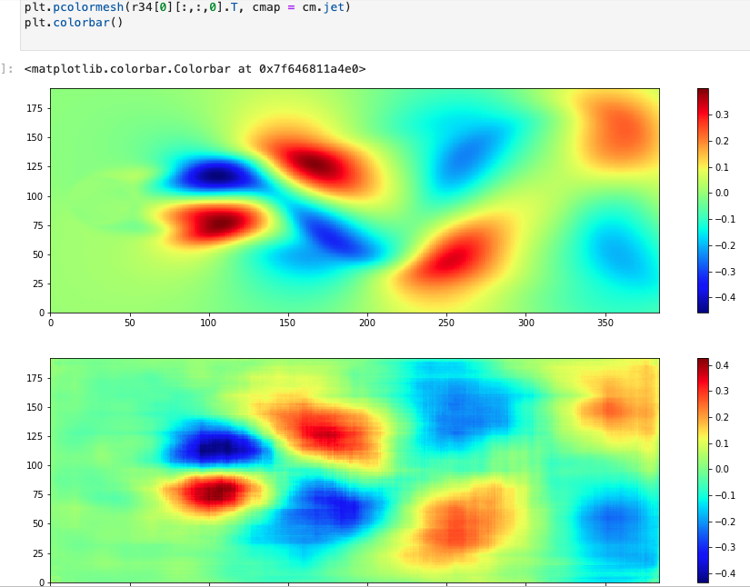
Original vs add(x3d,x4d) and add(x1d,x2d)
add(x1d,x2d)
add(x3d,x4d)

